Slide 1
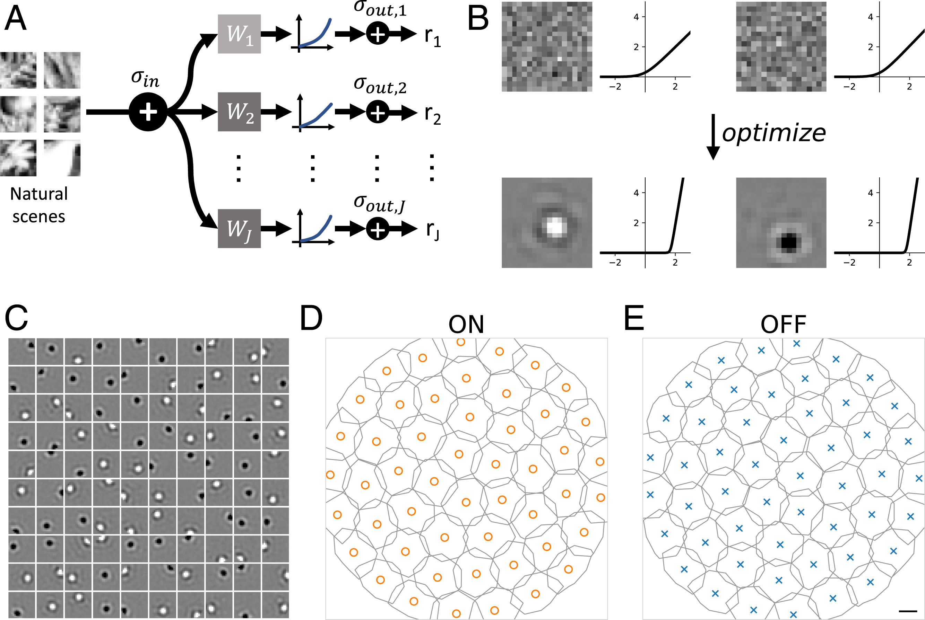

Slide 2
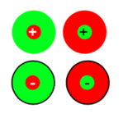

Color opponency in the retina
Red-green Retinal ganglion cells
Blue-yellow retinal ganglion cells

Slide 3
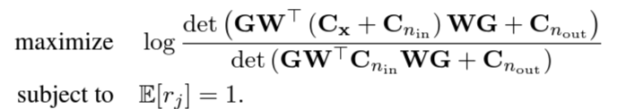
Optimizing mutual information

Slide 4
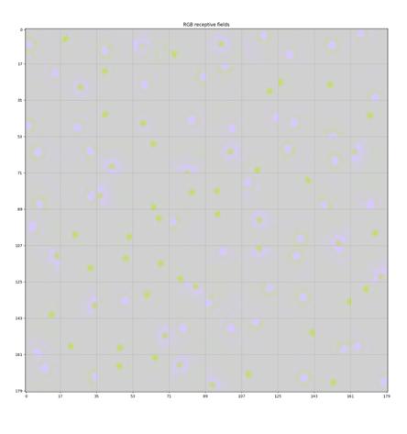
Receptive fields with unparametrized filters

Slide 5
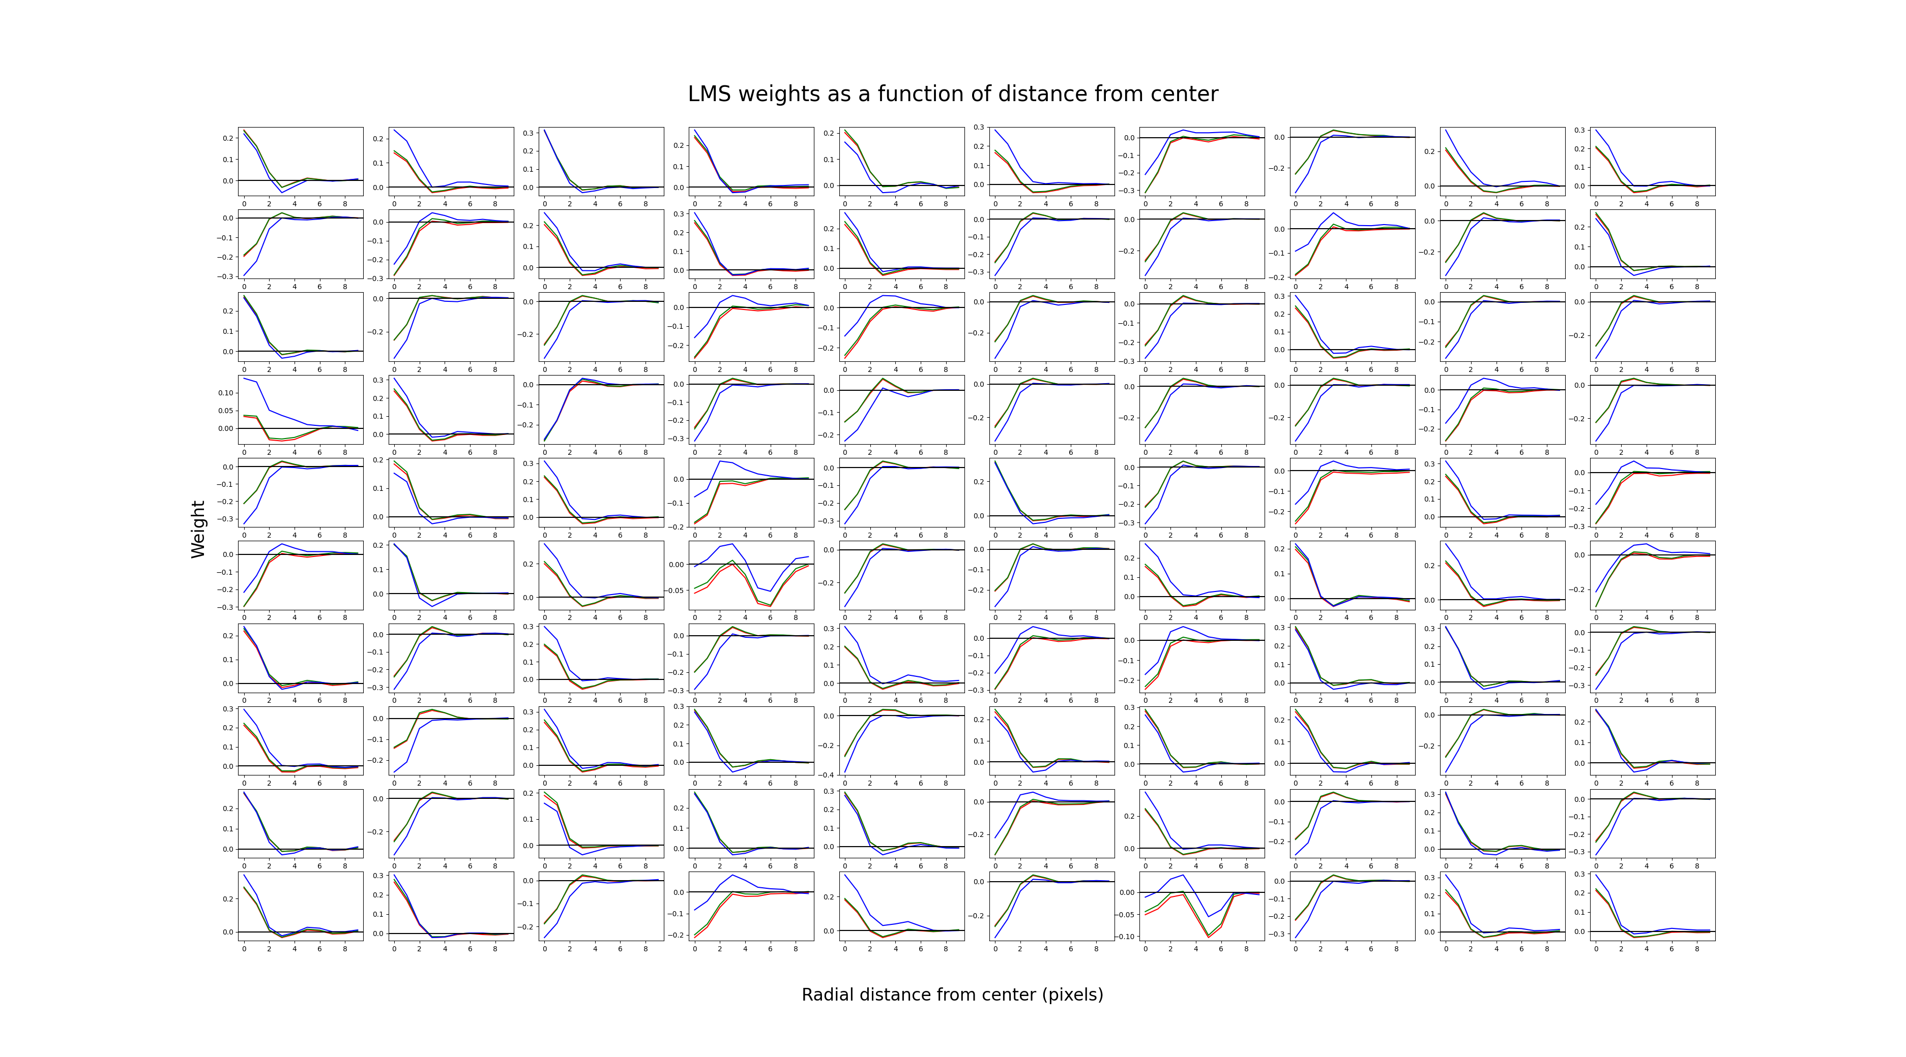

Slide 6

Parametrized Gaussian filters
Allows to train more neurons faster
Still a work in progress

